Slide 1
Introduction to machine learning
Introduction
R. Brooks

Slide 2



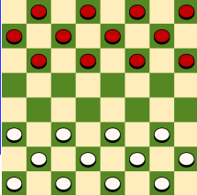


What is Machine Learning?
Tasks
Experience (Training Data)
Training
“A computer program is said to learn from experience E with respect to some
class of tasks T and performance measure P
if its performance at tasks in T, as measured by P, improves with experience E.”
(Tom Mitchell, 1997)
Learning algorithm
Prediction
Performance measure
Goal
Result

Slide 3

Why use Machine Learning?
The Challenge of Traditional Programming
Traditional coding struggles with tasks like handwriting recognition.
Understanding nuances (e.g., differentiating between '2' and '7') is complex.
Our brains excel at this, but how can we teach a computer?

Slide 4

Why use Machine Learning?
The Machine Learning Solution
Learning from Examples: We feed the machine examples rather than explicit instructions.
Algorithm-Generated Programs: Machine learning algorithms create flexible programs based on data.
Adaptability: These programs generalize to recognize new examples beyond the training set.

Slide 5
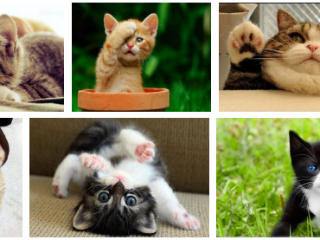
Solving Complex Problems with Machine Learning
Traditional Approach: Manually encode rules to solve problems.
Challenge:
Difficult to define explicit rules for complex tasks (e.g., recognizing cats in images).
Machine Learning Approach:
Learn from Data: Develop a solution by learning from examples.
Trial and Error: Refine the approach by experimenting and learning from mistakes.
Outcome: The system creates its own set of rules from the learning process.

Slide 6
Example: Titanic

Slide 7


Who?
Richard Brooks: rib@via.dk
Frederik Thorning Bjørn: frbj@via.dk

Slide 8
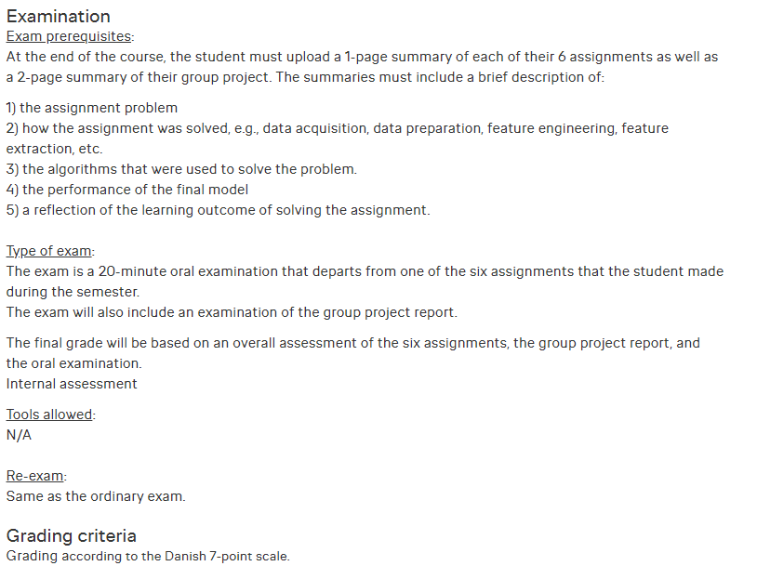
Evaluation

Slide 9
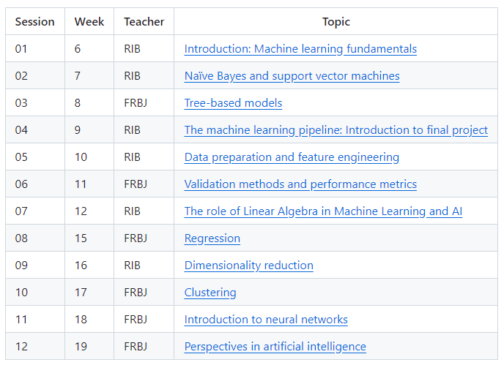
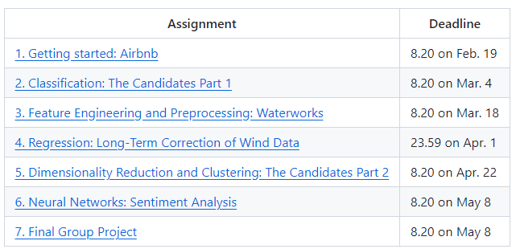
The Overview (changes may occur!)
Course homepage

Slide 10
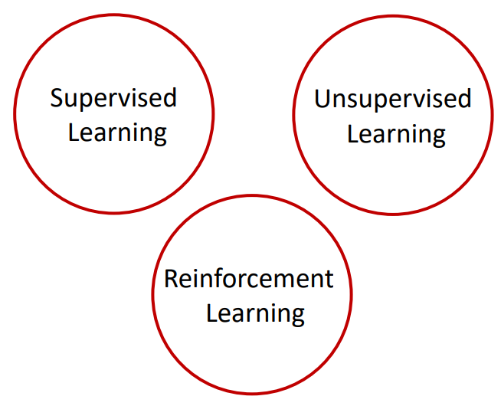
Taxonomy of Machine Learning (A Simplistic View Based on Tasks)

Slide 11

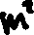





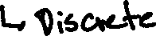
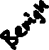

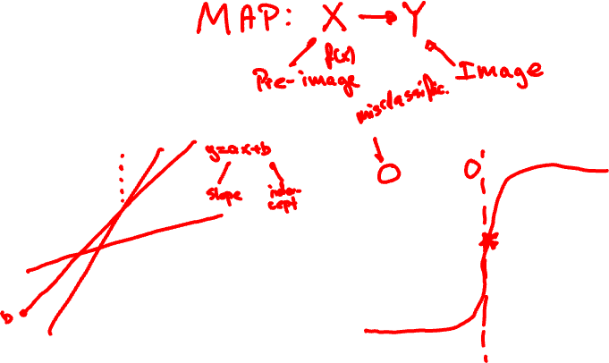

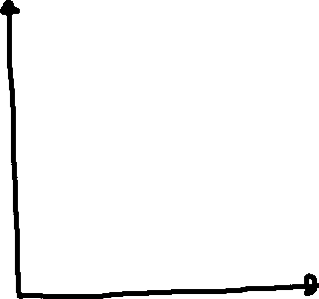


Supervised

Slide 12

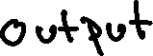









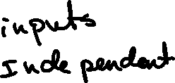


Slide 13
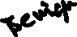
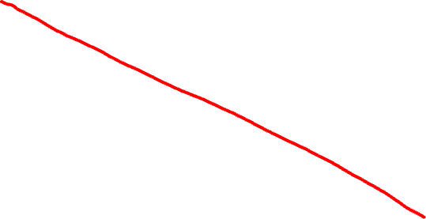
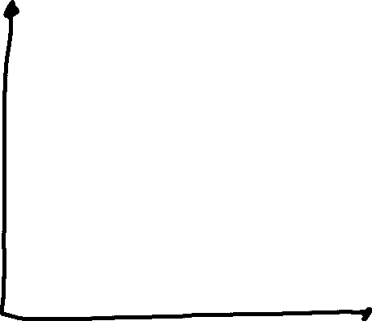
Supervised

Slide 14

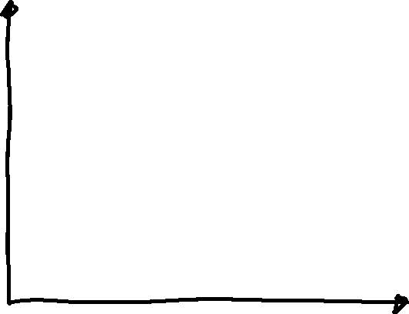


Unsupervised

Slide 15
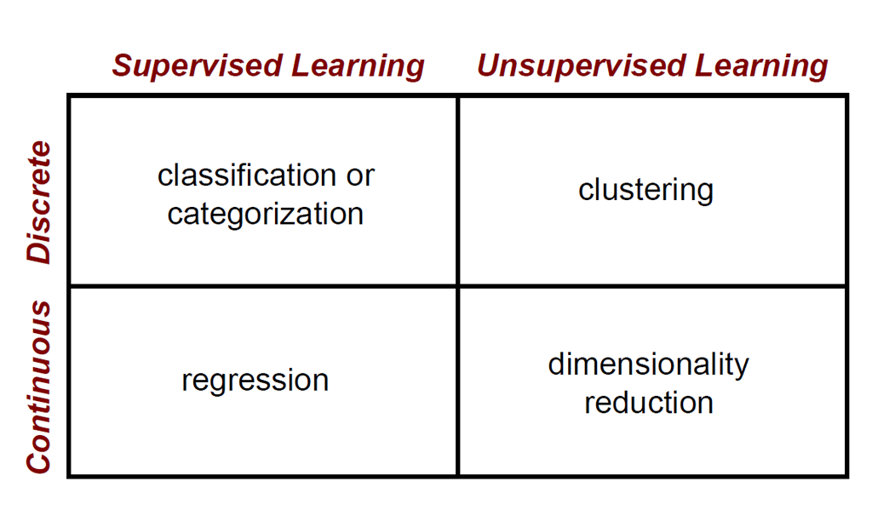
Machine Learning Problems

Slide 16
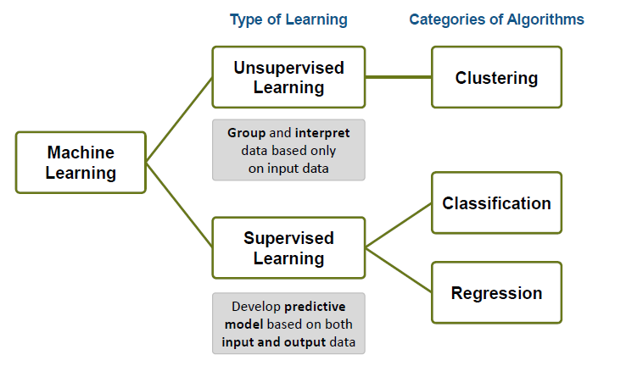
Machine Learning – An Overview

Slide 17
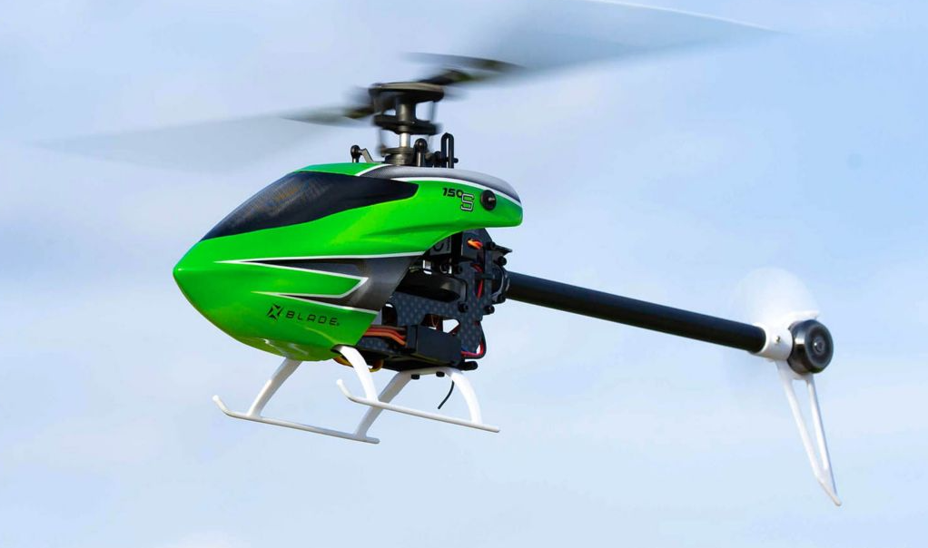
Reinforcement Learning

Slide 18
Machine learning methodology
Data
Machine learning algorithm
Training data
Trained
model
Features
Labels
Labels
New data
Predicted
label
Only features!

Slide 19
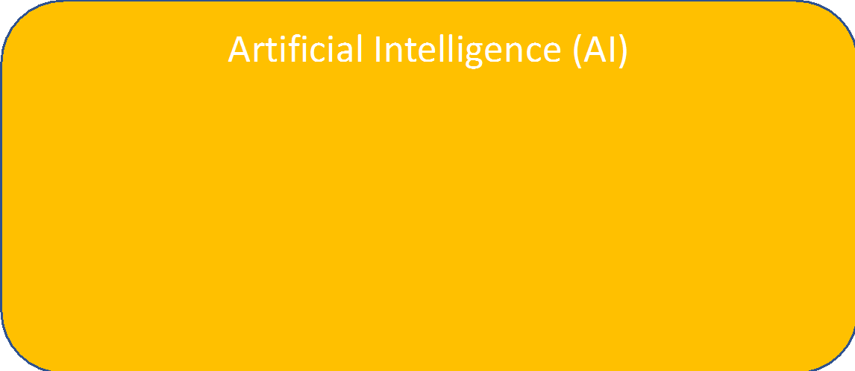
Artificial Intelligence: Key Facts
Real-world Data
Classification, Probability, Prediction
Machine Learning (ML)
Supervised Learning
Unsupervised Learning
Reinforcement Learning
Deep Learning

Slide 20

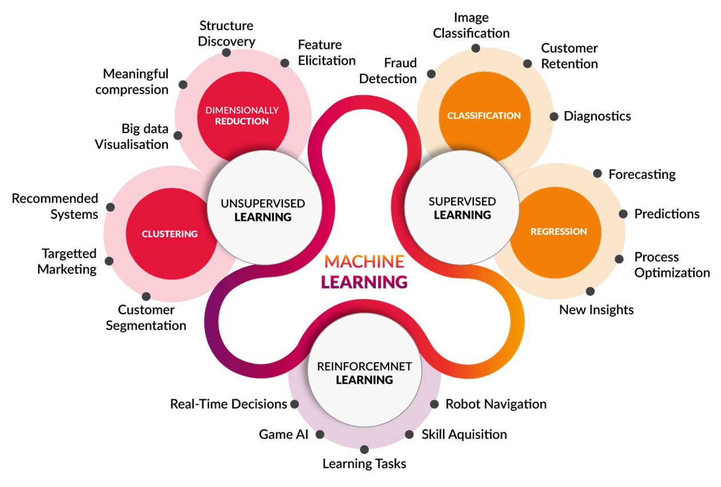
There are many types of machine learning!
Image source: http://www.cognub.com/index.php/cognitive-platform/

Slide 21


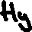
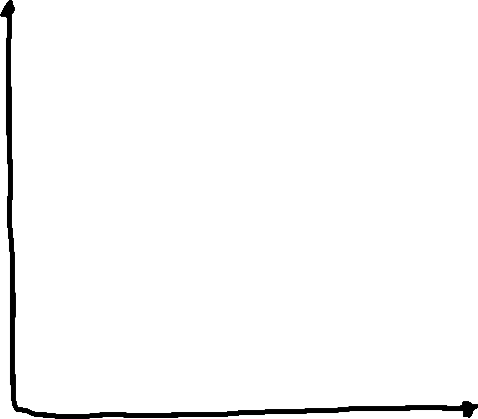




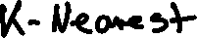


Slide 22
Value of K
Choosing the value of k:
If k is too small, sensitive to noise points
If k is too large, neighborhood may include points from other classes

Slide 23
Definition of Nearest Neighbor
K-nearest neighbors of a record x are data points that have the k smallest distance to x

Slide 24
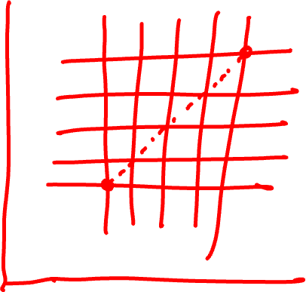
Overview of Distance Metrics in Machine Learning

Slide 25
Overview of Distance Metrics in Machine Learning

Slide 26
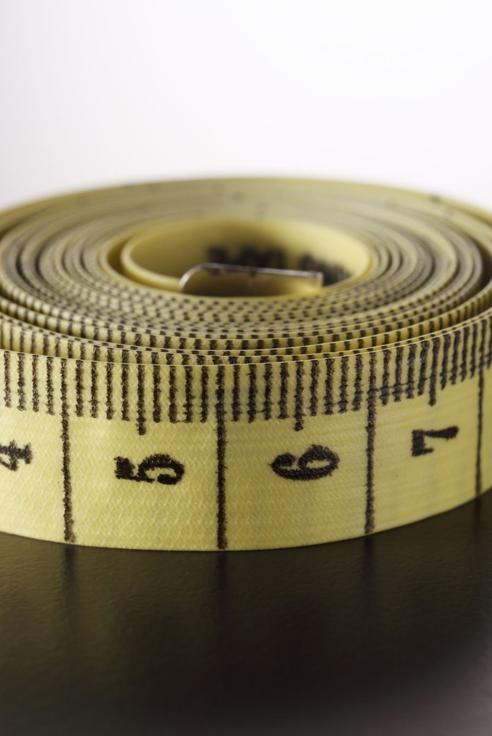
Distance Measure: Scale Effects
Different features may have different measurement scales
E.g., patient weight in kg (range [50,200]) vs. blood protein values in ng/dL (range [-3,3])
Consequences
Patient weight will have a much greater influence on the distance between samples
May bias the performance of the classifier

Slide 27
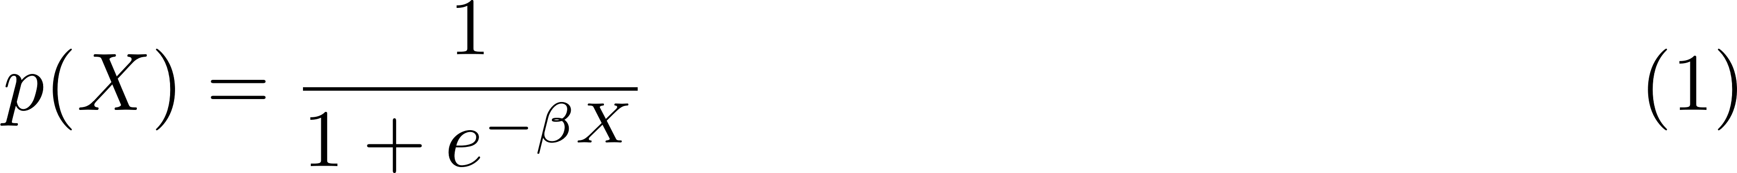
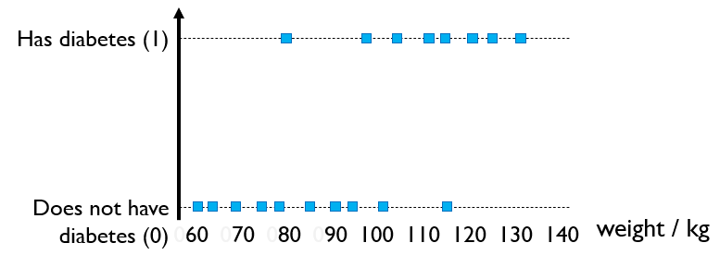
Logistic Regression
A classification model (not regression, despite the name)
Divides the problem space with hyperplanes
Works with linearly separable data
The sigmoid function

Slide 28
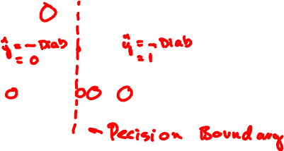
Logistic Regression
A classification model (not regression, despite the name)
Divides the problem space with hyperplanes
Works with linearly separable data

Slide 29
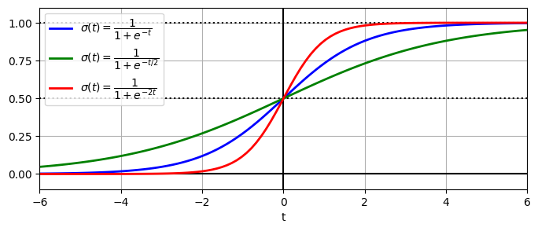
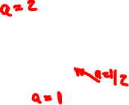



Impact of coefficients

Slide 30
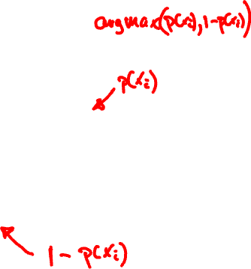
Maximum Likelihood
For a given line, calculate the likelihood of observing each point/person
Multiply all numbers

Slide 31
Maximum likelihood
Has diabetes (1)
Does not have diabetes (0)
weight / kg
060 070 080 090 100 110 120 130 140
multiplying all numbers yields 0.00024

Slide 32
Maximum likelihood
Has diabetes (1)
Does not have diabetes (0)
weight / kg
060 070 080 090 100 110 120 130 140
multiplying all numbers yields 0.00017
multiplying all numbers yields 0.00024

Slide 33
Maximum likelihood
Has diabetes (1)
Does not have diabetes (0)
weight / kg
060 070 080 090 100 110 120 130 140
multiplying all numbers yields 0.00005
multiplying all numbers yields 0.00017
multiplying all numbers yields 0.00024

Slide 34
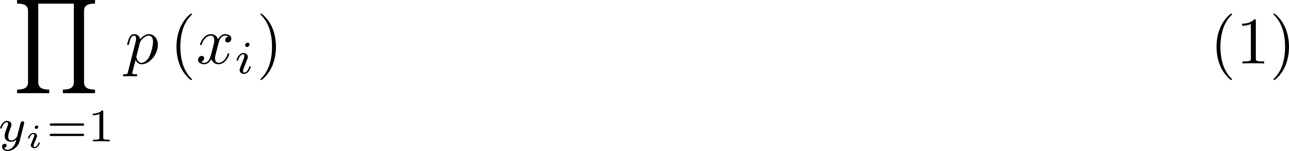
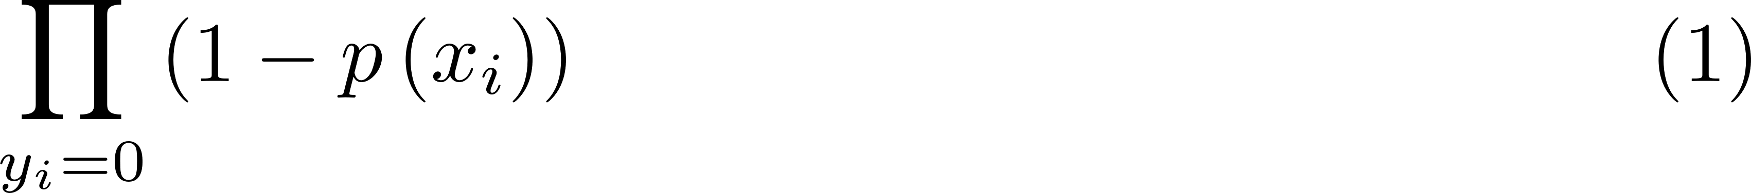

Some Math
Likehood

Slide 35
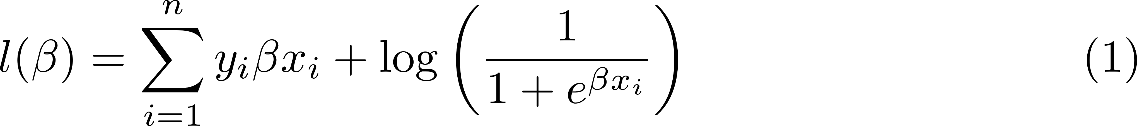
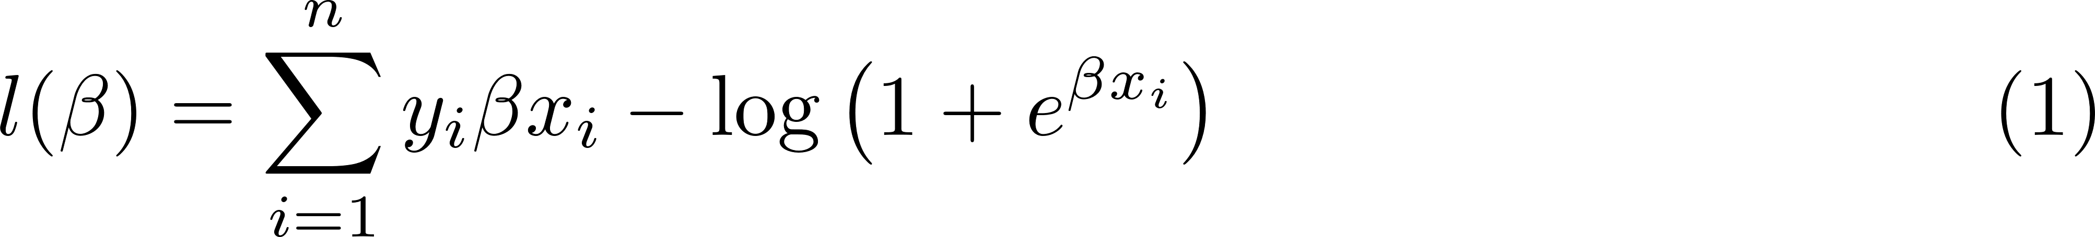
Some Math

Slide 36
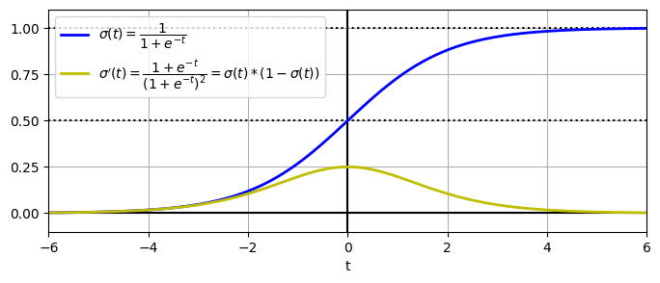
This is what needs to be optimised
Gradient descent or (variations of) Newton iteration
Both use the derivative

Slide 37
Test accuracy
Tune hyperparameters
Data
Machine learning algorithm
Training data
Trained
model
Features
Labels
Labels
Testing data
New data
Predicted
label
Only features!

